Slide 1
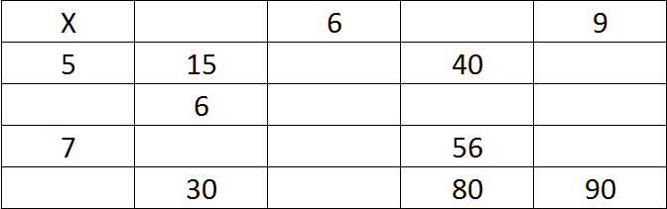
Converting Fractions, Decimals and Percentages.
LO: 2ba2 convert FDP using appropriate methods.
Starter:
Copy &
Complete

Slide 2
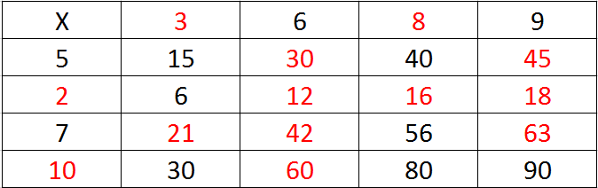
Converting Fractions, Decimals and Percentages.
LO: 2ba2 convert FDP using appropriate methods.
Answers

Slide 3
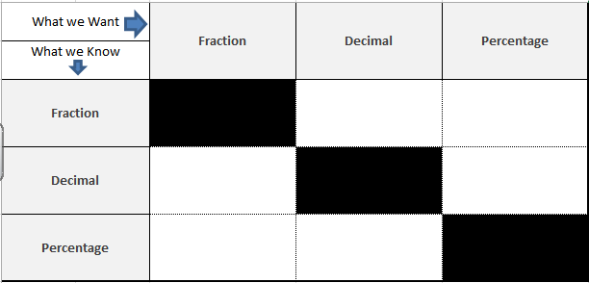

Conversion help sheet
Numerator ÷ Denominator
(Bus-stop method)
Create an equivalent fraction with a denominator of 100
Use knowledge of place value.
0.23 (the 3 is 3 hundredths = $\frac{23}{100})$
X 100
(Multiply by 100)
÷ 100
(Divide by 100)
Put over 100 and then simplify

Slide 4
Conversion help sheet

Slide 5
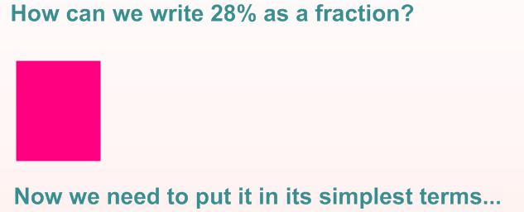
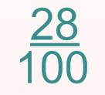
Percentages to Fractions

Slide 6
Conversion help sheet
Put over 100 and then simplify

Slide 7
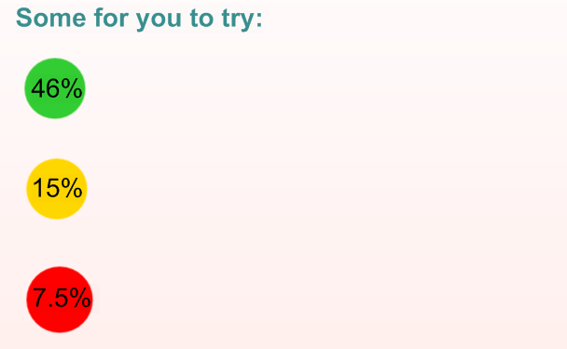

Slide 8
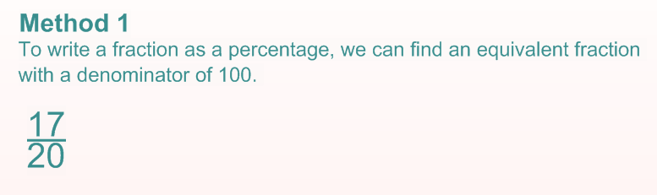
Fraction to a Percentage

Slide 9
Conversion help sheet
Create an equivalent fraction with a denominator of 100
Put over 100 and then simplify

Slide 10
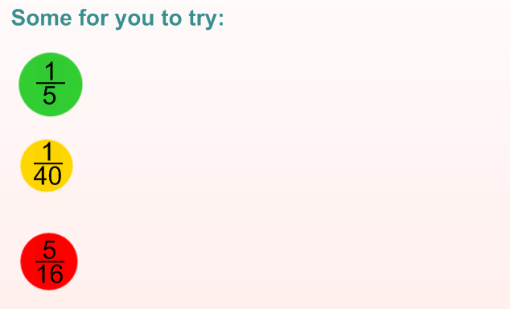

Slide 11
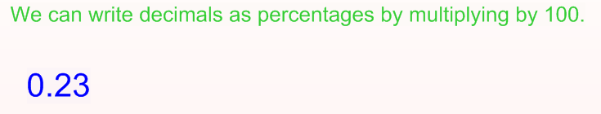
Decimal to a Percentage

Slide 12
Conversion help sheet
Create an equivalent fraction with a denominator of 100
X 100
(Multiply by 100)
Put over 100 and then simplify

Slide 13
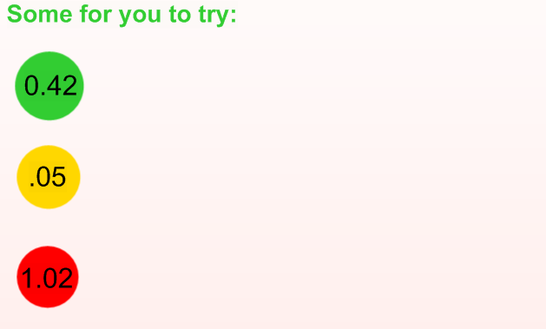

Slide 14
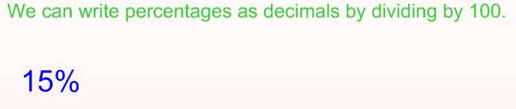
Percentage to a Decimal

Slide 15
Conversion help sheet
Create an equivalent fraction with a denominator of 100
X 100
(Multiply by 100)
÷ 100
(Divide by 100)
Put over 100 and then simplify

Slide 16
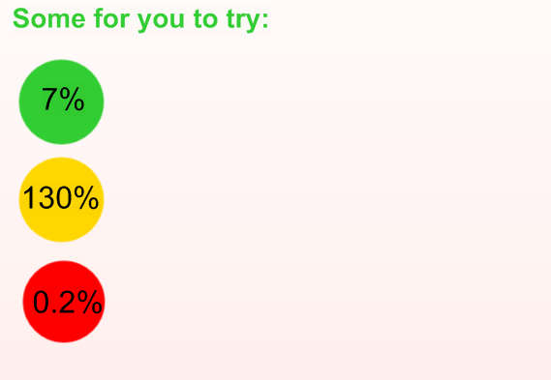

Slide 17
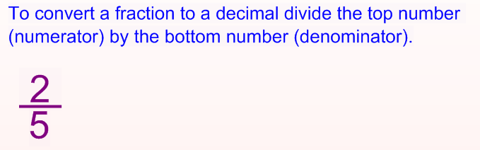
Fraction to a Decimal

Slide 18
Conversion help sheet
Numerator ÷ Denominator
(Bus-stop method)
Create an equivalent fraction with a denominator of 100
X 100
(Multiply by 100)
÷ 100
(Divide by 100)
Put over 100 and then simplify

Slide 19
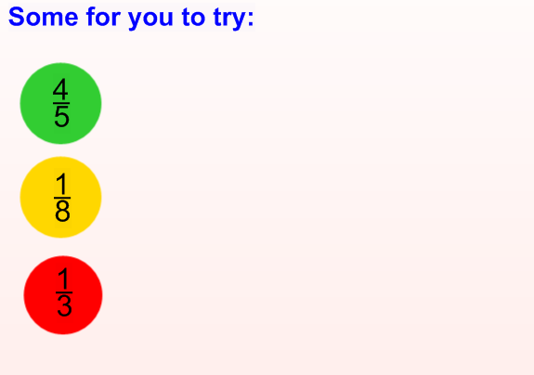

Slide 20
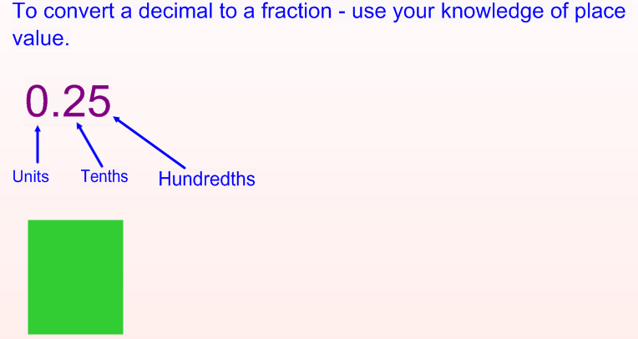

Decimal to a Fraction

Slide 21

Conversion help sheet
Numerator ÷ Denominator
(Bus-stop method)
Create an equivalent fraction with a denominator of 100
Use knowledge of place value.
0.23 (the 3 is 3 hundredths = $\frac{23}{100})$
X 100
(Multiply by 100)
÷ 100
(Divide by 100)
Put over 100 and then simplify

Slide 22
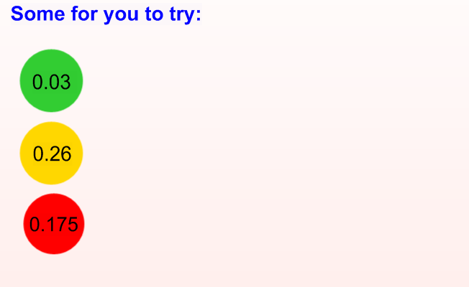

Slide 23
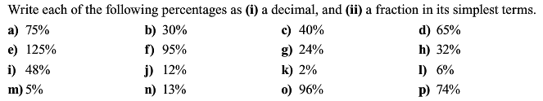
Percentages Conversions i) Turn into a decimal ii) Turn into a fraction and simplify

Slide 24
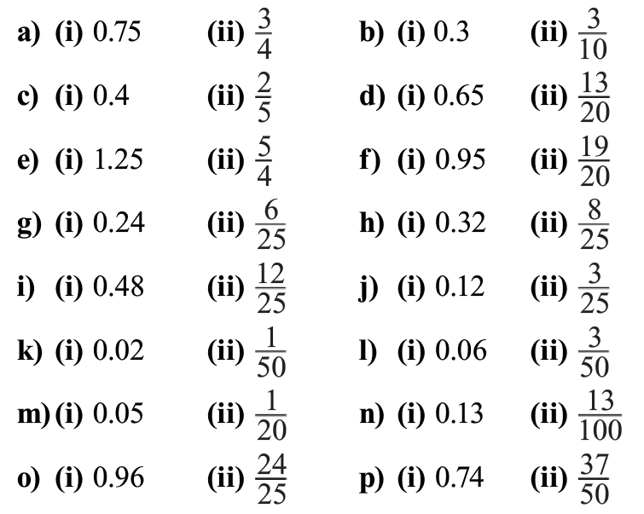
Answers

Slide 25
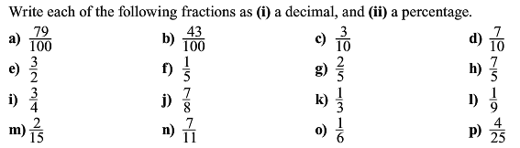
Fractions Conversions i) Turn into a decimal ii) Turn into a percentage

Slide 26
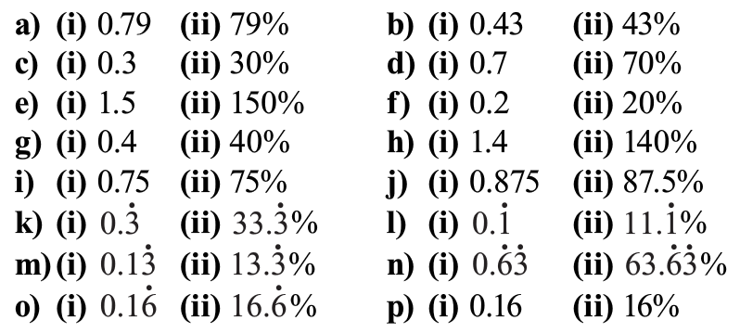
Answers

Slide 27
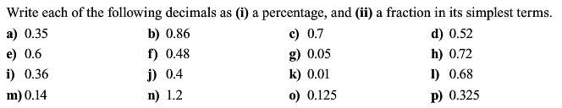
Decimals Conversions i) Turn into a percentage ii) Turn into a fraction and simplify

Slide 28
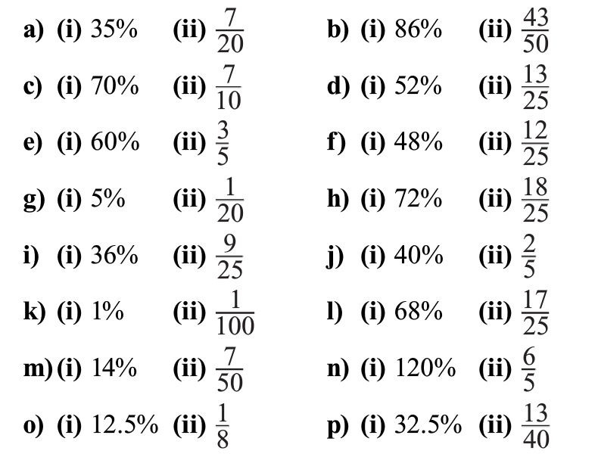
Answers

Slide 29
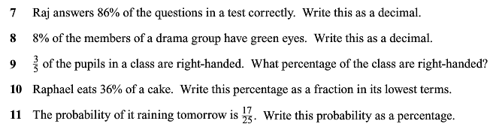
Worded Questions

Slide 30
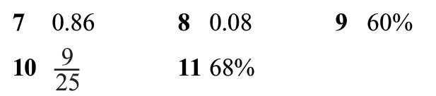
Answers

Slide 31
Students sheets

Slide 32
Conversion help sheet
Numerator ÷ Denominator
(Bus-stop method)
Create an equivalent fraction with a denominator of 100
Use knowledge of place value.
0.23 (the 3 is 3 hundredths = $\frac{23}{100})$
X 100
(Multiply by 100)
÷ 100
(Divide by 100)
Put over 100 and then simplify

Slide 33
Percentages to Fractions

Slide 35
Fraction to a Percentage

Slide 37
Decimal to a Percentage

Slide 39
Percentage to a Decimal

Slide 41
Fraction to a Decimal

Slide 43
Percentages Conversions i) Turn into a decimal ii) Turn into a fraction and simplify

Slide 44
Fractions Conversions i) Turn into a decimal ii) Turn into a percentage

Slide 45
Decimals Conversions i) Turn into a percentage ii) Turn into a fraction and simplify

Slide 46
Worded Questions

